Slide 1



1 mi

Slide 2












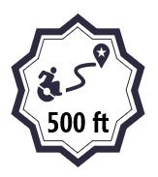
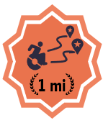
500 ft
0.25 mi
0.5 mi
1 mi
5 mi
0.25 mi
0.5 mi
500 ft
500 ft
500 ft
500 ft
500 ft
500 ft
50

Slide 3












500 ft
0.25 mi
0.5 mi
1 mi
5 mi
500 ft
500 ft
500 ft
500 ft
500 ft
500 ft
500 ft

Slide 4
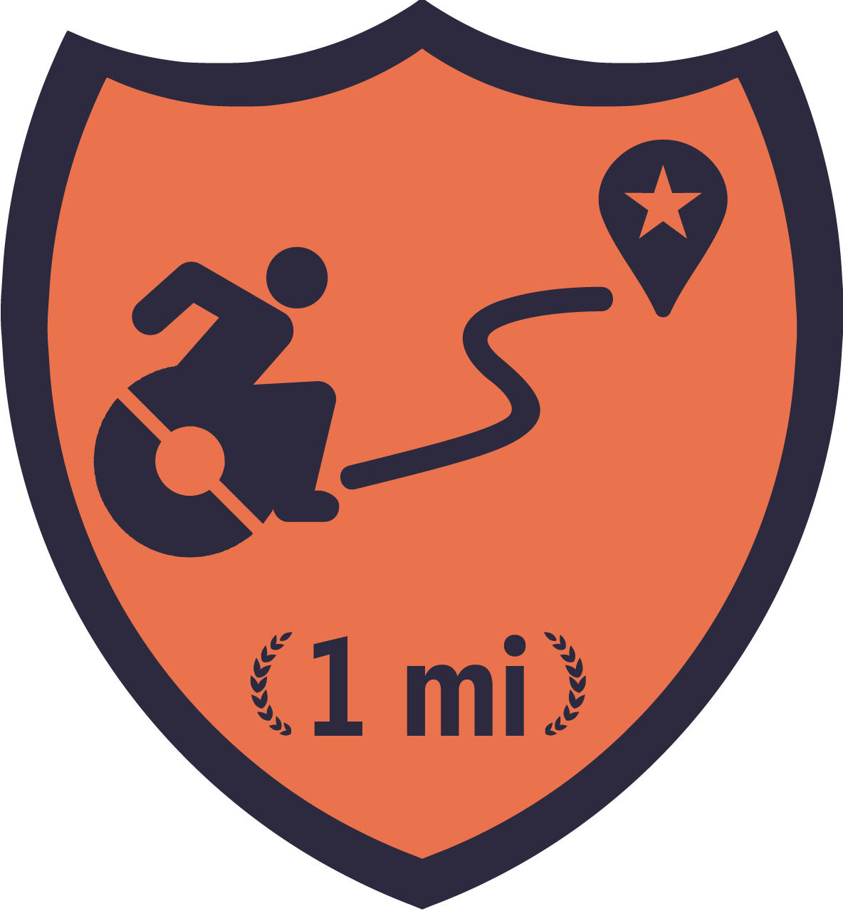

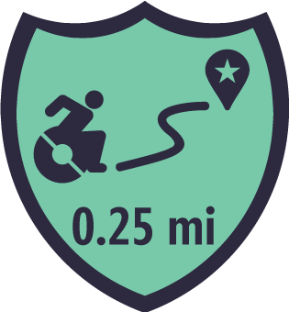
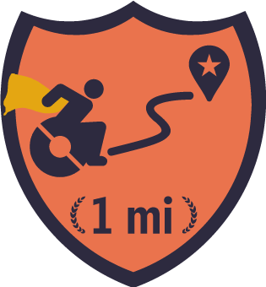
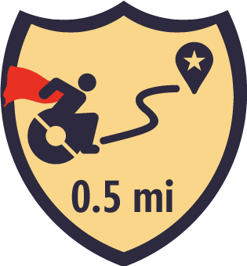
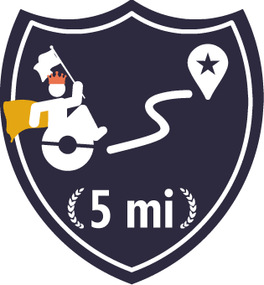
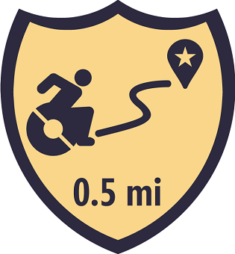

Slide 5




100
500
1k
5k

Slide 6


100
250
500
1k
5k
100
250
500
1k
5k
100
250
500
1k
5k
100
250
500
1k
5k

Slide 7



100
250
500
1k
5k
50
250
500
1k
5k
250

Slide 8



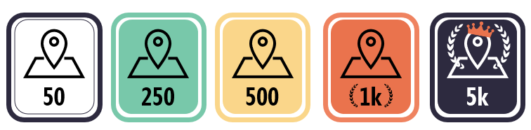
100
250
500
1k
5k
50
250
500
1k
5k
50
250
500
1k
5k
250

Slide 9
50
250
500
1k
5k

Slide 10





10
100
10
10
5
10
20
5
20
20
20
5
10
20
50
100

Slide 11


5
10
20
50
100
100

Slide 12
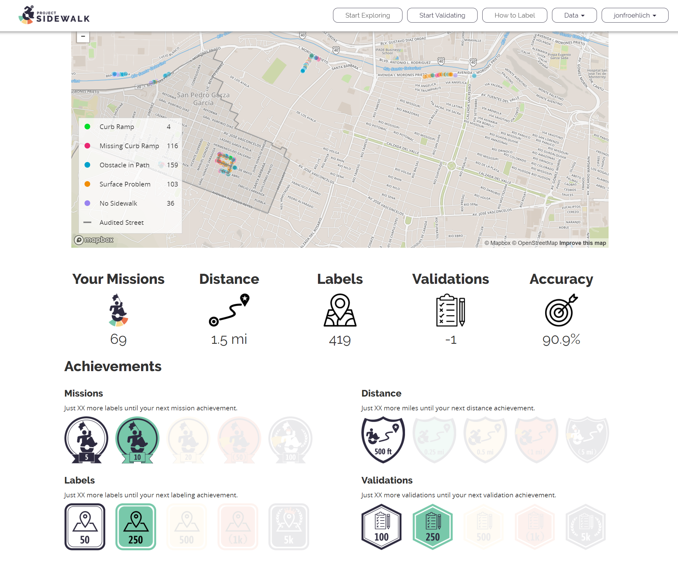

Slide 13

Badges for:
Most accurate
Distance levels (0.5 mi, 1 mi, 5 mi, 10 mi+)
Num Labels (100, 500, 1k, 10k, 50k, 100k)
Num missions
Num validations

Slide 14
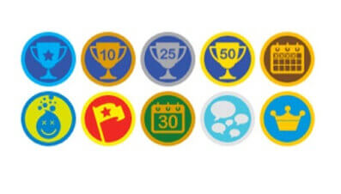



Slide 15
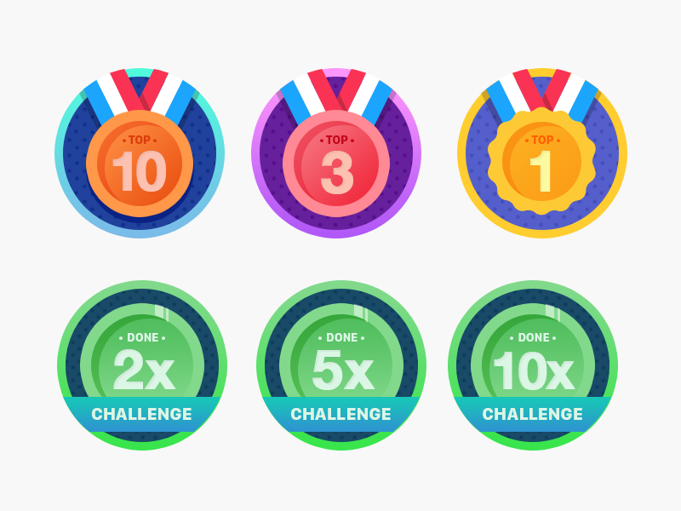

Slide 16

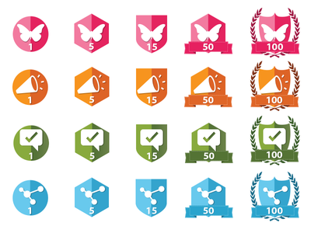


Notes:
https://thenounproject.com/search/?q=wreath&i=203146

Slide 17


Slide 18
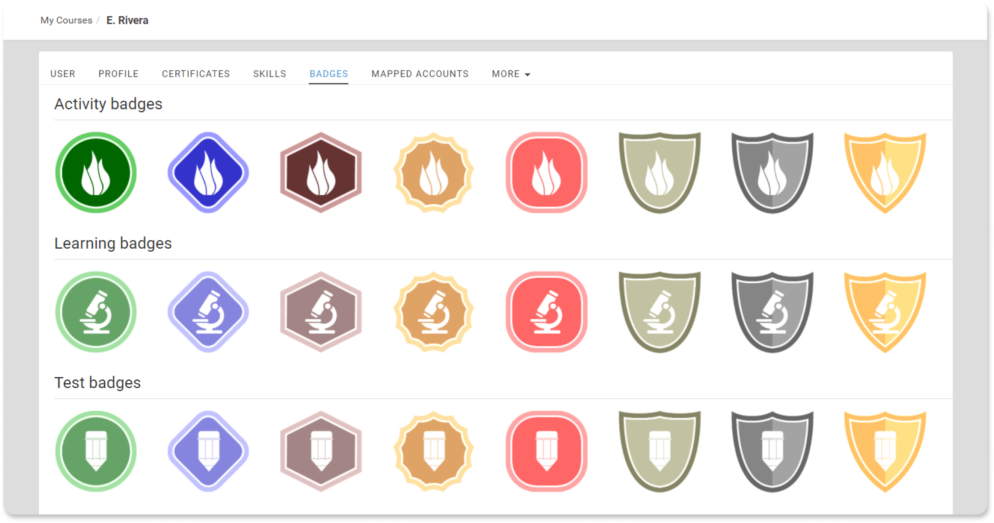

Slide 19









1st
1st
99th
4th
3rd
2nd
1st
8th
5
10
20
50
100

Slide 20
1st
1st
99th
4th
3rd
2nd
1st
5th
5
10
20
50
100
8th

Slide 21

1st
1st
99th
4th
3rd
2nd
1st
8th

Slide 22

1st
1st
99th
4th
3rd
2nd
1st
8th

Slide 23
TODO: try different types of trophies for 1st, 2nd, 3rd, 4th-10th?
On mission sidebar, show ranking overall as well as for current neighborhood

